Slide 1






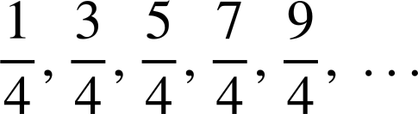
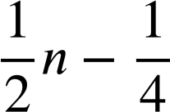
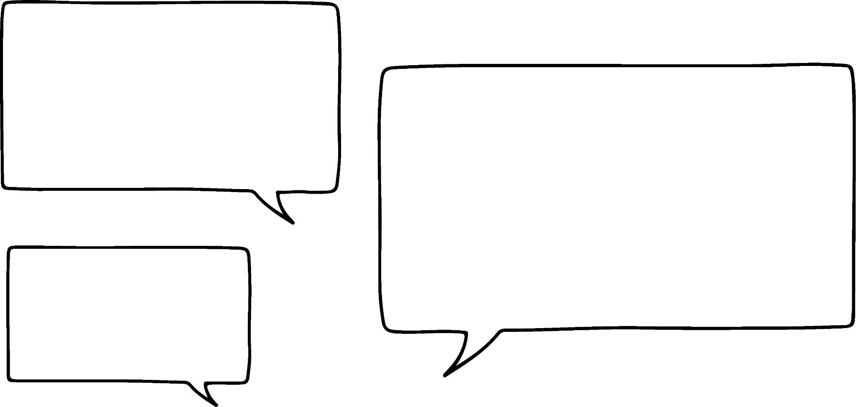

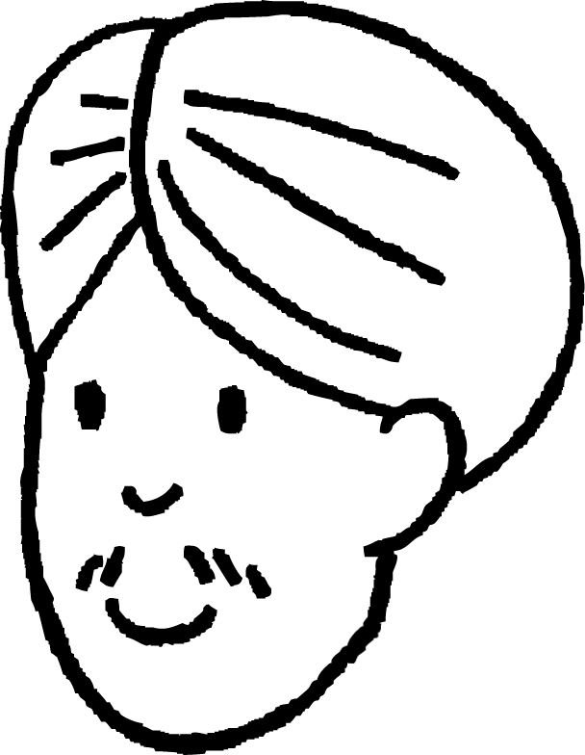



Finding the n^{th} term
Task A: Finding the n^{th} term of increasing sequences
1) Find the n^{th} term of the sequences below:
a)
b)
c)
d)
e)
2) Andeep says:
The sequence -5, -3, -1, 1, 3, … is because the common difference is +2 and it starts at -5
Give two explanations as to why Andeep is wrong.
The number line may help.
The sequence 2n starts:
-7
-7
-7
Your sequence is a translation by -7 therefore it is
n = 1
2(1) - 5 = -3
The first term of the sequence is -3 whereas your first term is -5 so can not describe your sequence.

Slide 2










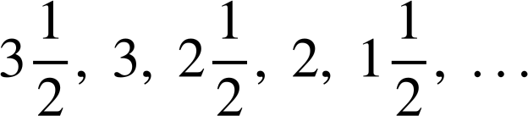
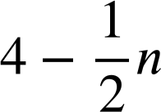



Finding the n^{th} term
Task B: Finding the n^{th} term of decreasing sequences
1) Match the sequences to their n^{th} term.
2) Find the n^{th} term of these sequences.
a)
d)
b)
e)
c)
f)
3) Two students are discussing arithmetic sequences.
If you give me any two terms of an arithmetic sequence I can tell you the n^{th} term.
You’re right Aisha! If we had 30 and 25 we’d know it’s 30, 25, 20, 15, 10, … with an n^{th} term of 35 - 5n
Aisha
Write a sentence to explain if Aisha and Sofia are right.
Sofia
You might have written:
You need to know which two terms you have. If 30 and 25 are terms one and two then yes, it’s 35 - 5n.
But, if 30 and 25 are the fifth and sixth terms, then it’s a different sequence altogether.

Slide 3




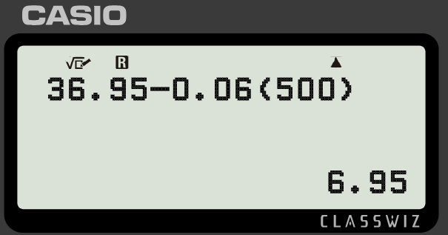
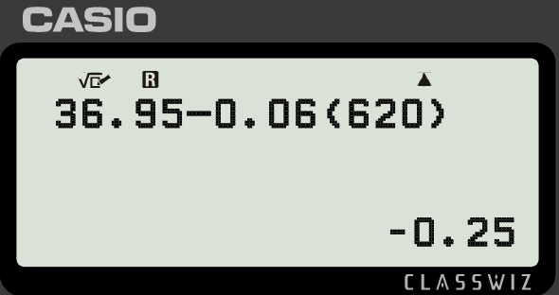
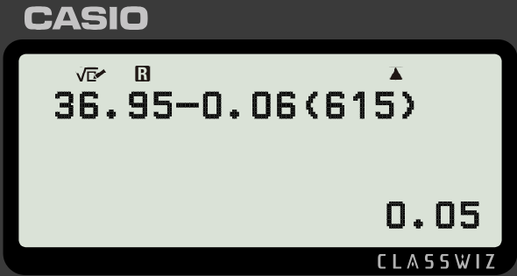
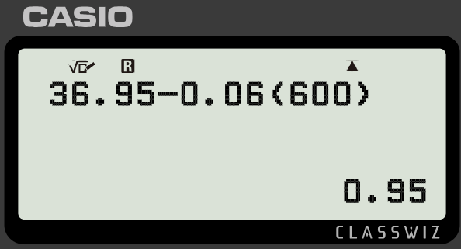
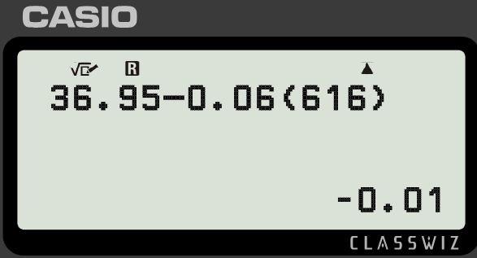
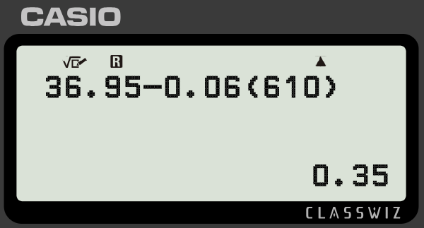
Finding the n^{th} term
Task C: Finding and using the n^{th} term
1) Find the n^{th} term, then use approximation and counting on to find the term 705 in the arithmetic sequence starting −25, −15, −5, 5, 15, …
n = 70 10(70) − 35 = 665
…, 665, 675, 685, 695, 705, …
70th
71st
72nd
73rd
74th
705 is the 74th term in the sequence.
2) Find the n^{th} term, then use approximation and counting on to find the term −554 in the arithmetic sequence starting −2, −14, −26, −38, −50, …
n = 50 10 − 12(50) = 10 − 600 = −590
…, −554, −566, −578, −590, …
47th
48th
49th
50th
-554 is the 47th term in the sequence.
3) Jacob wants to know the last term positive term in the sequence
Use trial and improvement on your calculator to help him.
The 615th term is positive. The 616th term is negative.
Therefore, the 615th is the last positive term.
Mathematics in Education and Industry
v2.2

